Slide 1
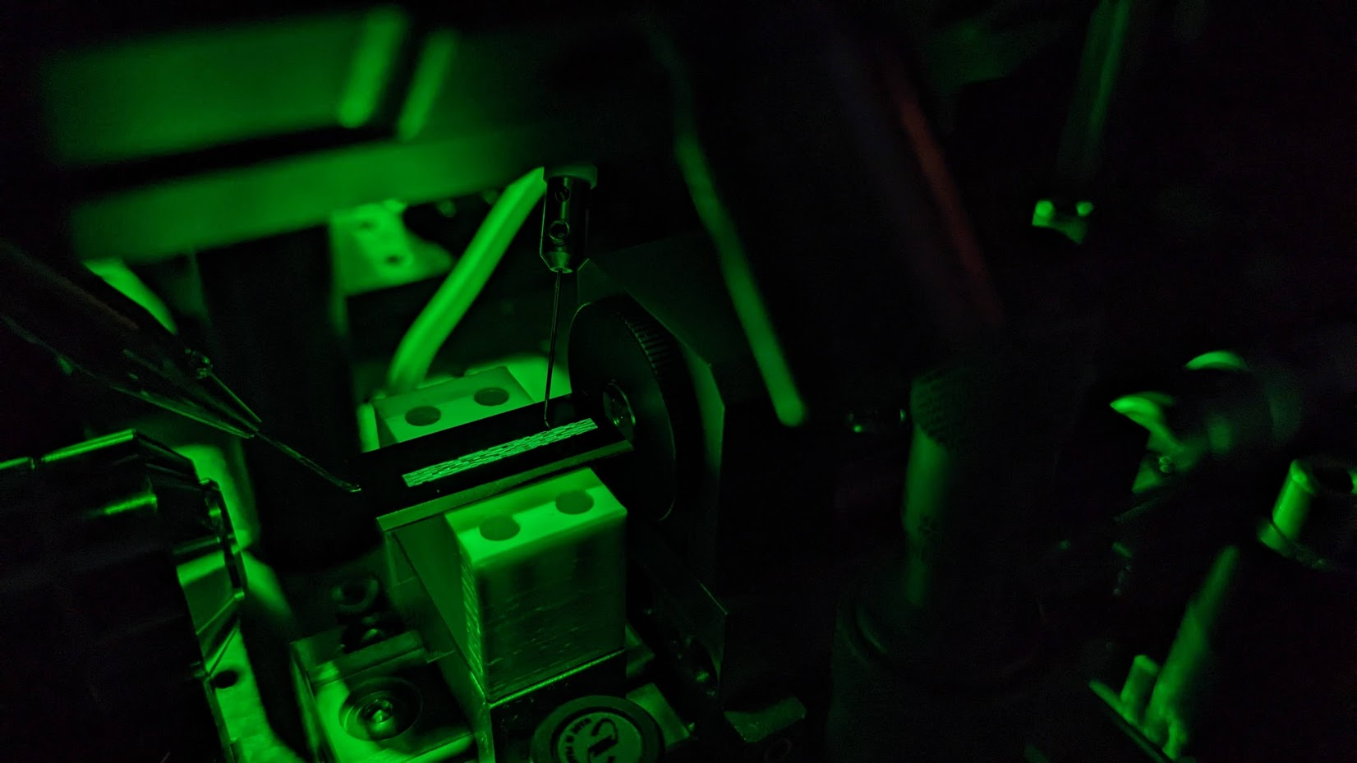
Programmable wave propagation for machine learning
Tatsuhiro Onodera
2024-01-08
Aspen Center for Physics Winter Conference 2024
Martin Stein (co-lead)
Logan Wright -> Yale Univ
Peter McMahon
(PI)
T. Onodera*, M.M. Stein*, B.A. Ash, M.M. Sohoni, M. Bosch, R. Yanagimoto, M. Jankowski, T.P. McKenna, T. Wang, G. Shvets, M.R. Shcherbakov, L.G. Wright, P.L. McMahon. Scaling on-chip photonic neural processors using arbitrarily programmable wave propagation (2024)
https://arxiv.org/abs/2402.17750

Slide 2
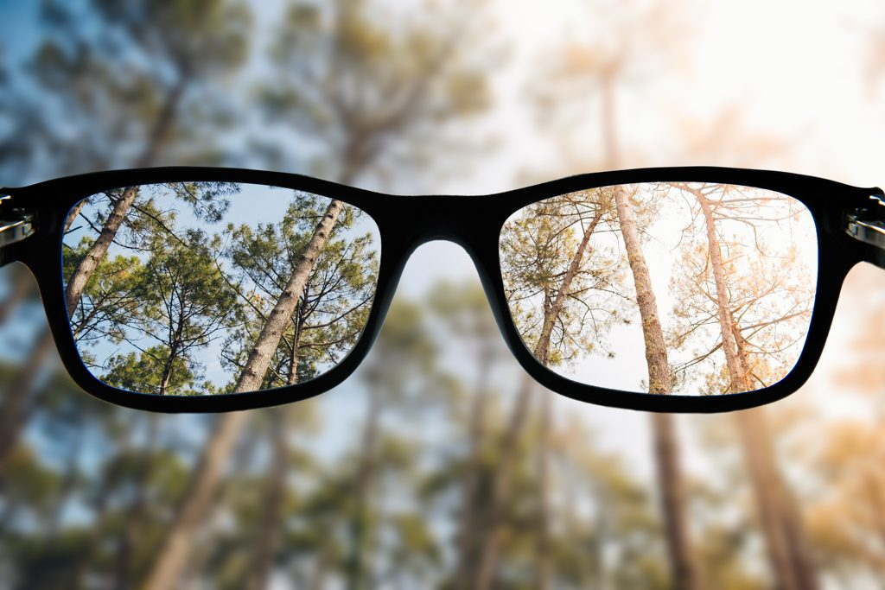
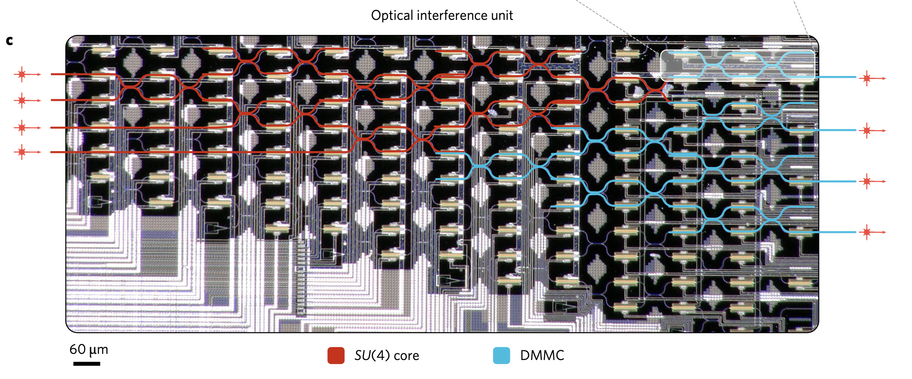
Machine learning with integrated photonics
Propagation of light passively performs computation
Performs matrix multiplication : $y_{i}=\sum_{j }{A_{ij}x_{j}}$
$$x_{1}$$
$$y_{1}$$
$$x_{2}$$
Input
$$x_{3}$$
$$y_{2}$$
$$x_{4}$$
$$y_{3}$$
Output
$$y_{4}$$
Shen et al. Nature Photonics 11, 441 (2017)

Slide 3
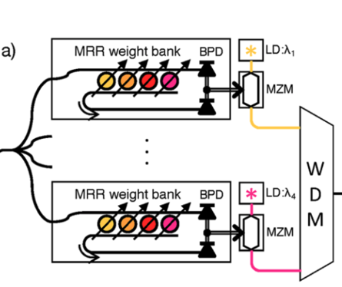
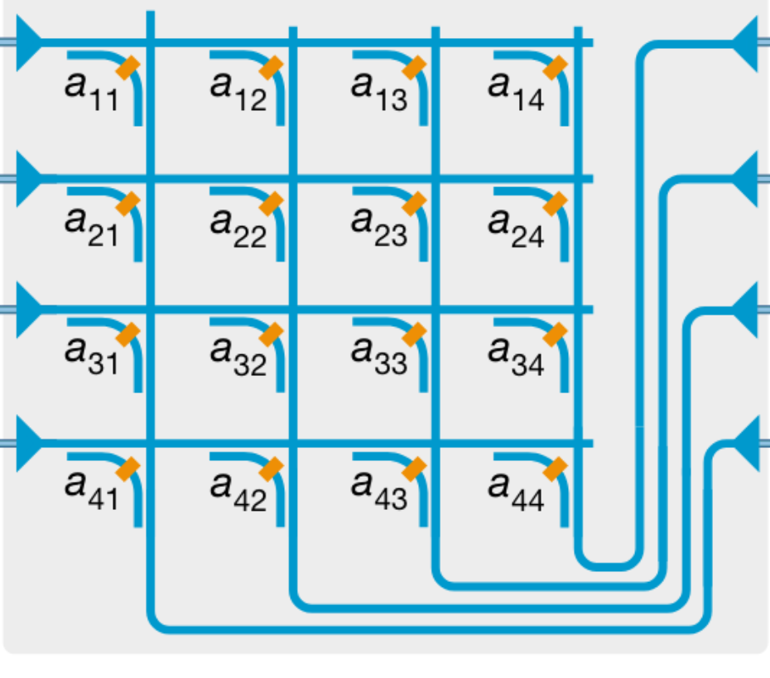
Machine learning with integrated photonics
Traditional approach: Focus on perfecting discrete elements and scaling them up.
Light travel in photonic wires (single-mode waveguide)
Each coupling element corresponds to a matrix element
$$x_{1}$$
$$y_{1}$$
$$x_{2}$$
$$x_{3}$$
$$y_{2}$$
$$x_{4}$$
$$y_{3}$$
$$y_{4}$$
Shen et al. Nature Photonics 11, 441 (2017)
Photonic cross-bar array: Nature 589, 52 (2021)
Microring resonator weight banks:
IEEE Quantum Electronics 22, 312 (2016)
Large components have limited computational complexity

Slide 4
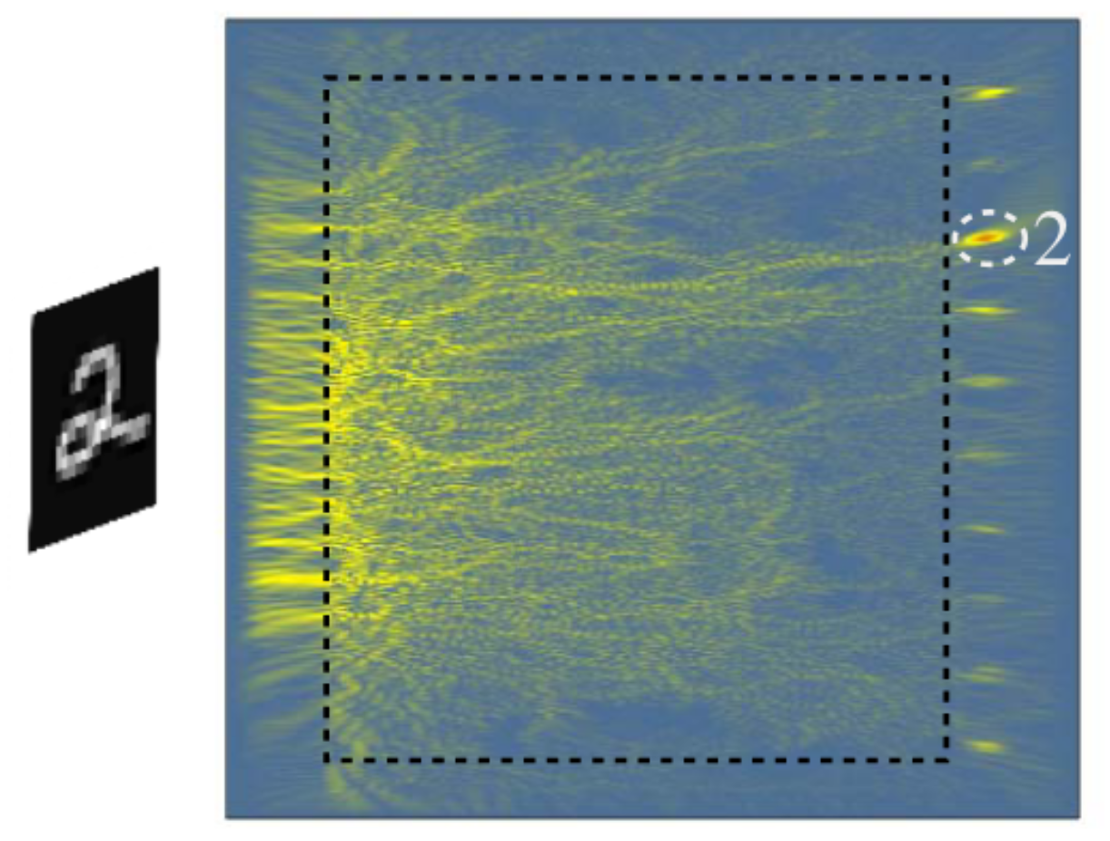
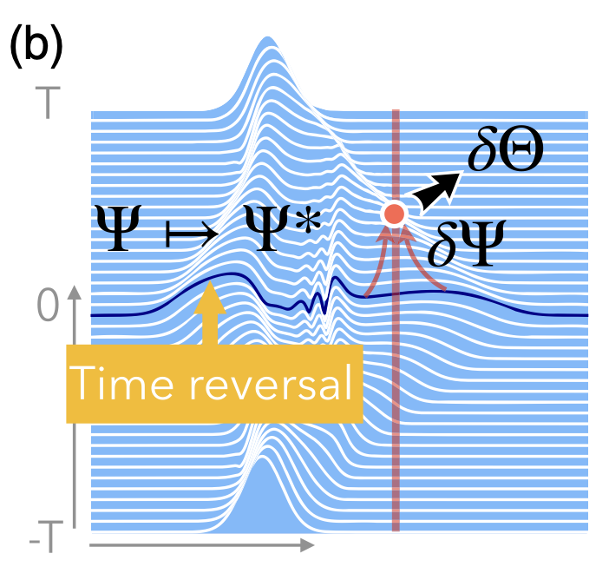
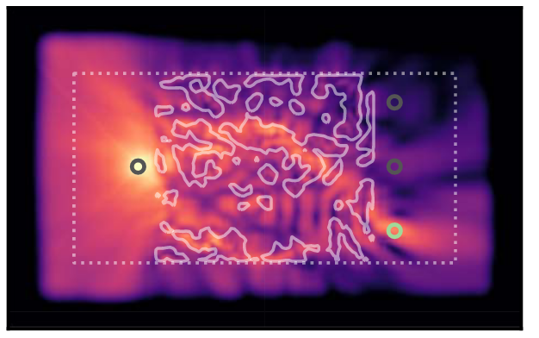
Letting go of abstractions: What if we use waves instead?
Erfan Khoram, …, Zongfu Yu, Photonics Research 7, 823 (2019)
Florian’s talk yesterday: PRX 13, 031020 (2023)
Tyler Hughes*, Ian Williamson*, ..., Shanhui Fan,
Science Advances 5 eaay6946 (2019)

Slide 5
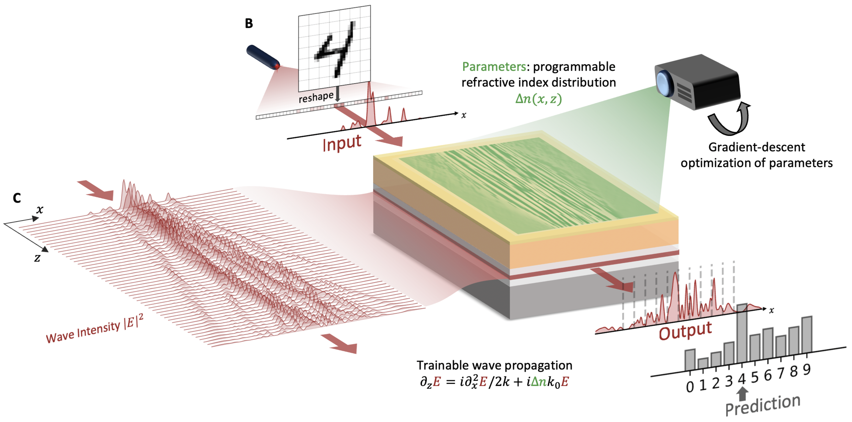
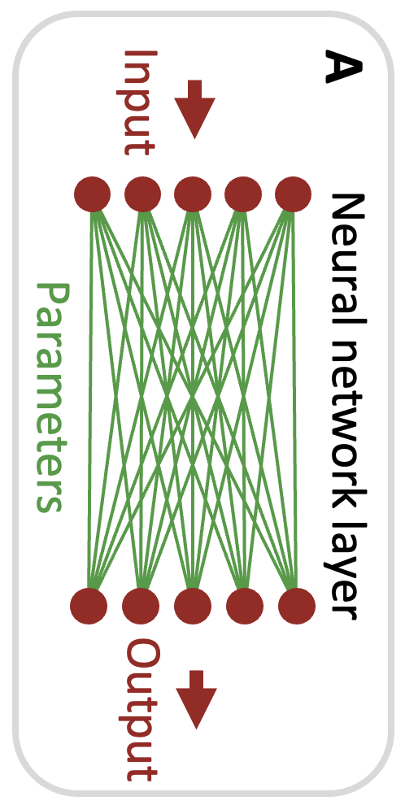
Our work: Build a 2D-programmable waveguide
2D-programmable waveguide: An optical chip whose spatial refractive index distribution is programmable in real time.
T. Onodera*, M. M. Stein*, B. Ash, …, L. G. Wright, and P. L. McMahon, Arbitrarily programmable optical wave propagation for high-dimensional machine learning (2023), manuscript in preparation.

Slide 6
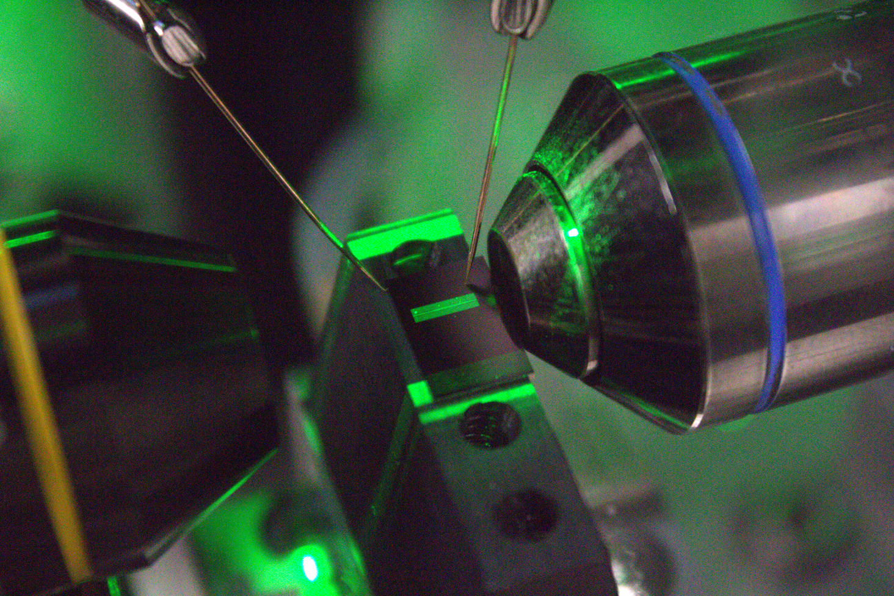
Input light
Output light

Slide 7
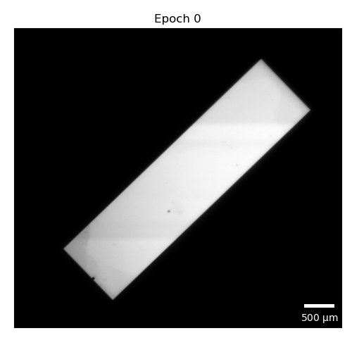

Slide 8
By shaping the light, can in-situ manipulate the wave propagation

Slide 9
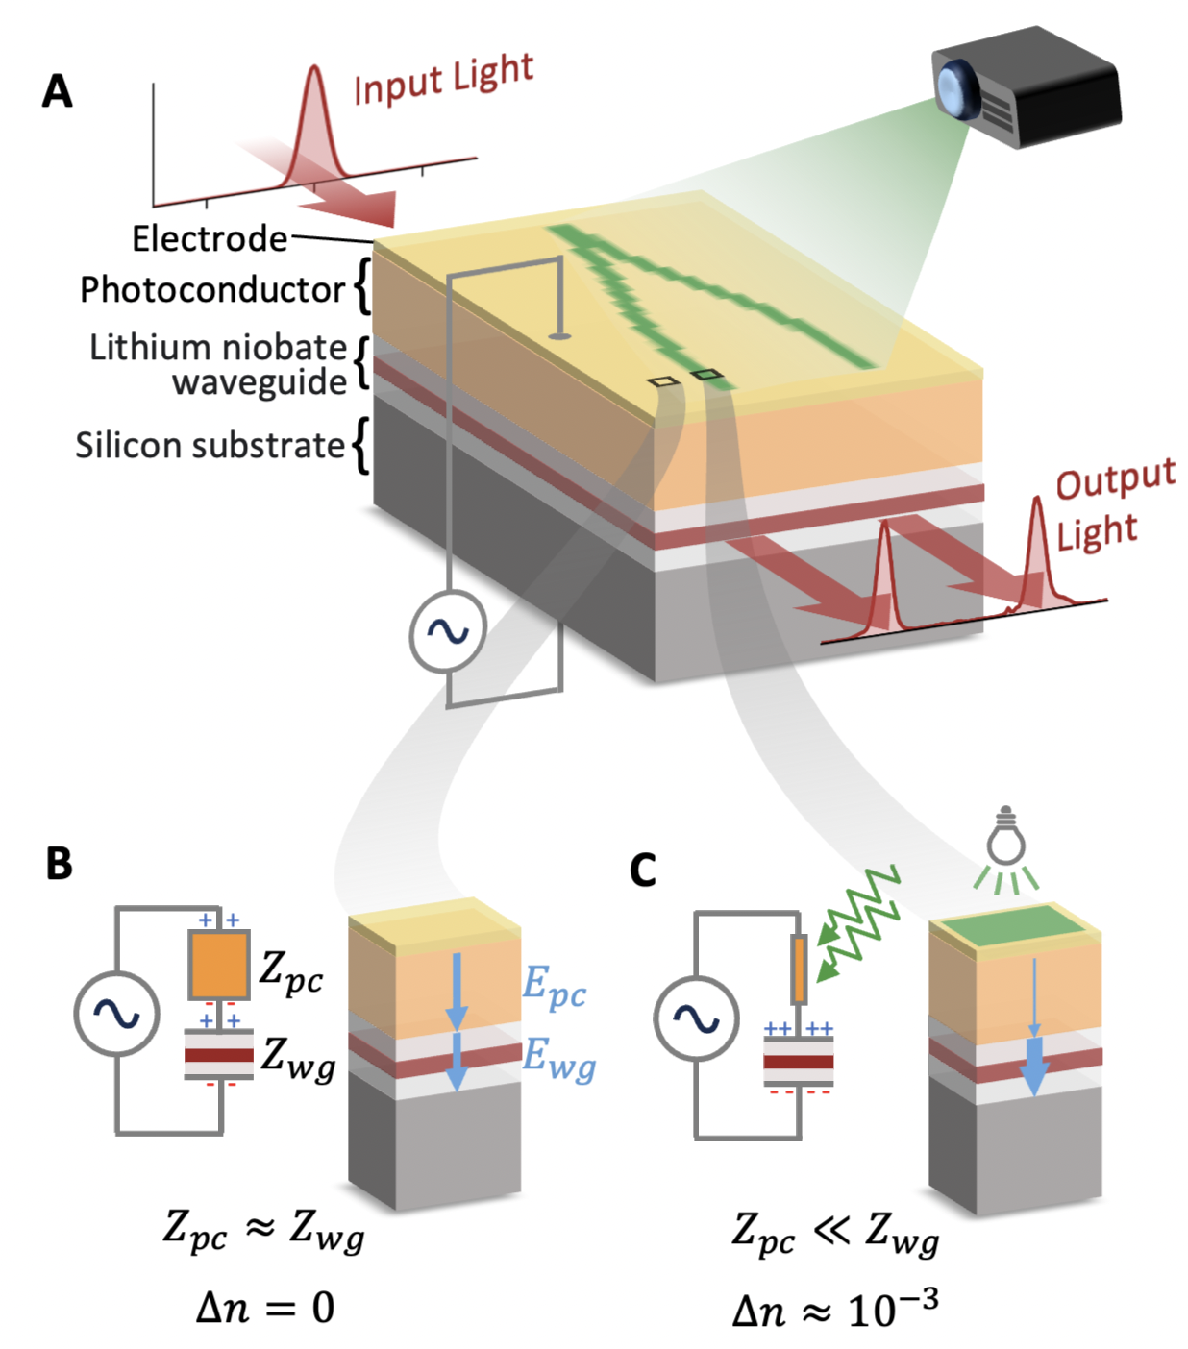
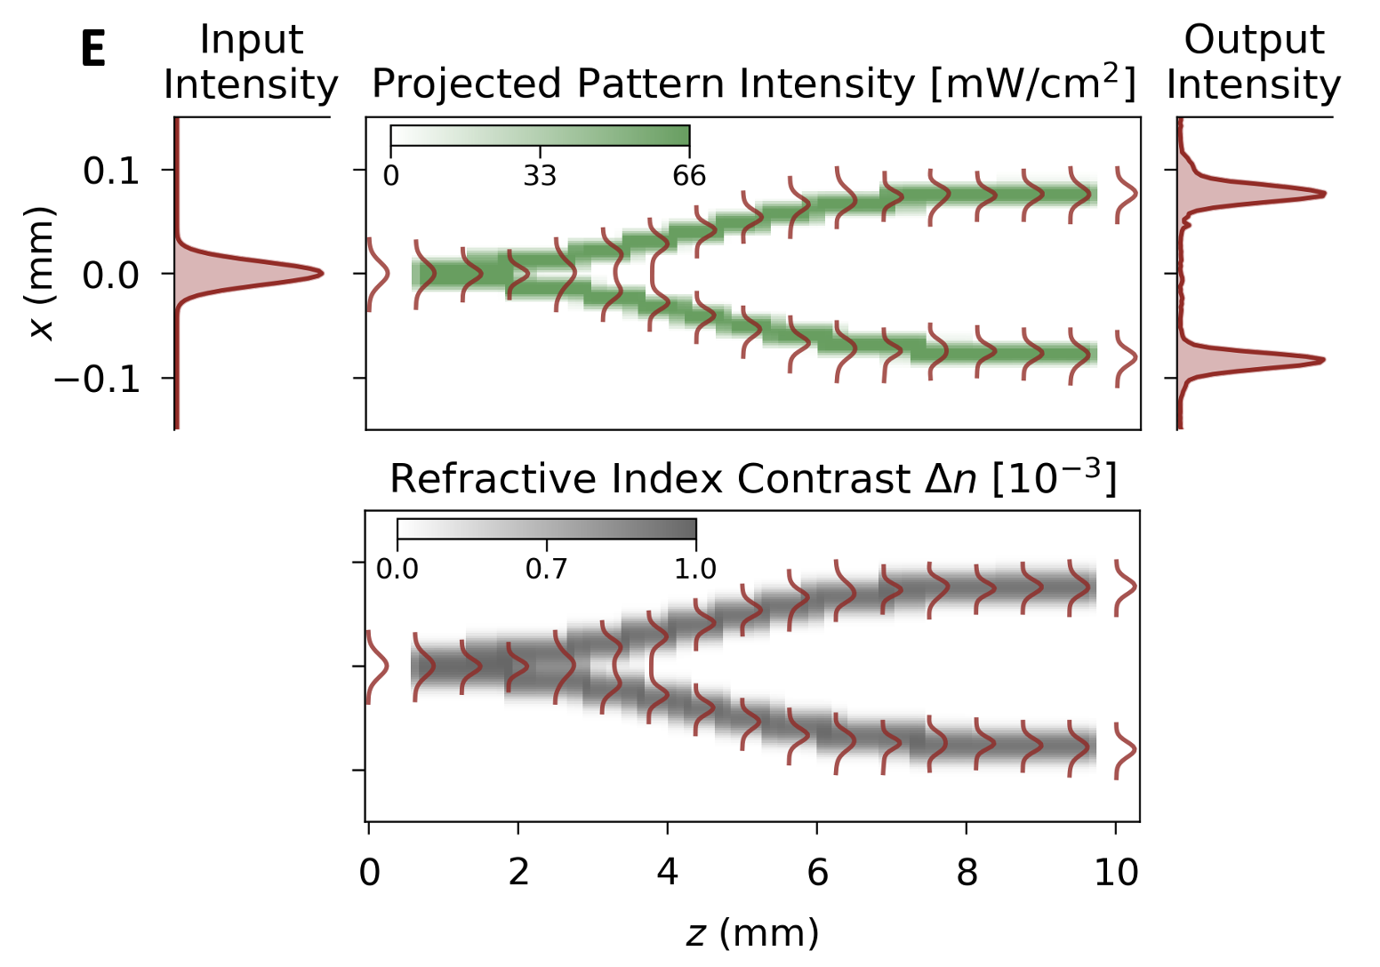
How the 2D-programmable waveguide works

Slide 10
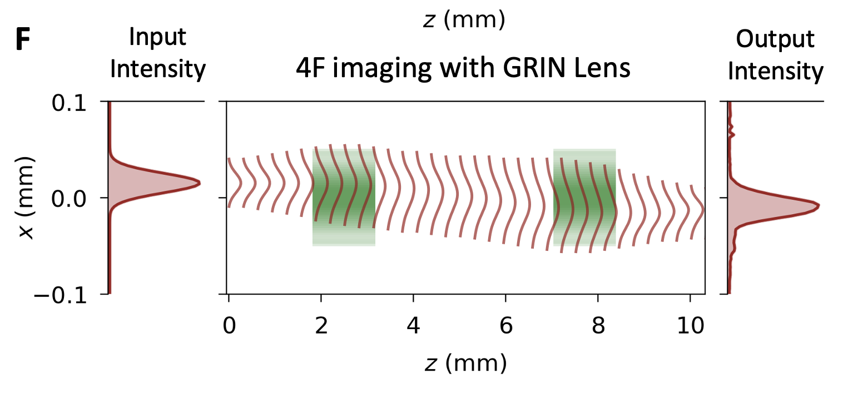
How the 2D-programmable waveguide works

Slide 11
Machine Learning Results

Slide 12
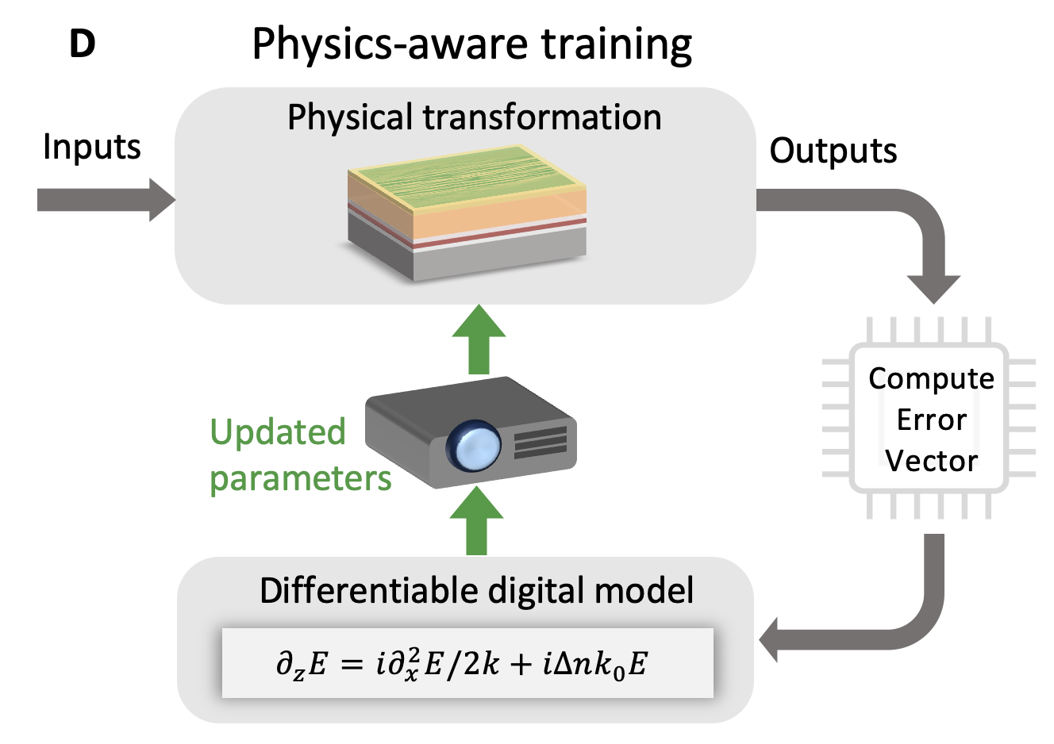
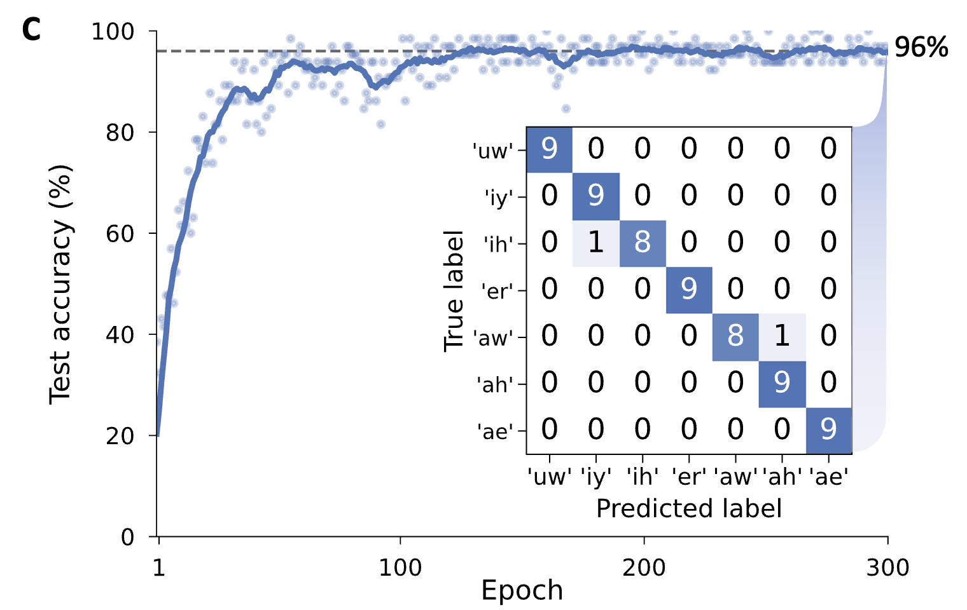
Machine Learning Results - Training
L.G. Wright*, T. Onodera*, M.M. Stein, ..., P.L. McMahon, Deep physical neural networks trained with backpropagation. Nature 601, 549 (2022)

Slide 13
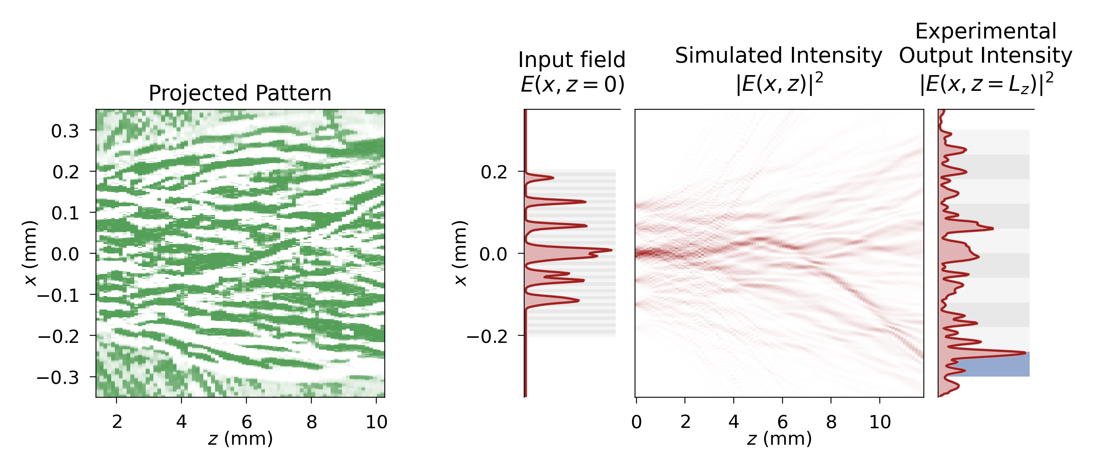
Machine Learning Results
Perform hand-written digit classification

Slide 14
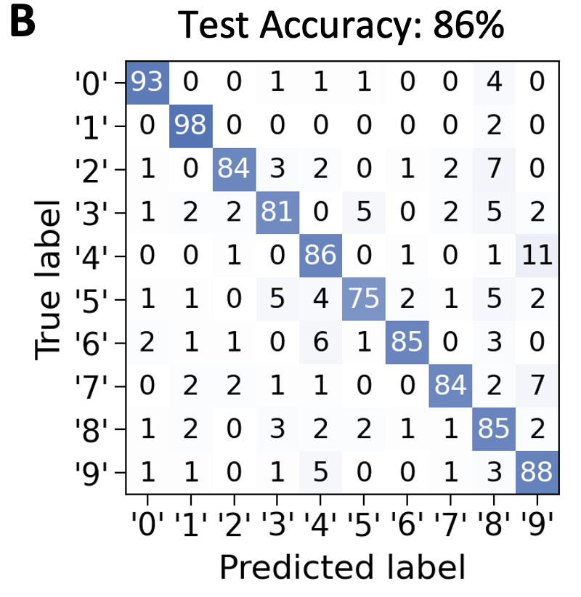
Machine Learning Results
Perform hand-written digit classification
1 layer digital NN achieves 90%

Slide 15
Acknowledgments
Ben Ash
Mandar Sohoni
Ryotatsu Yanagimoto
Tianyu Wang -> Boston Univ
Logan Wright -> Yale Univ
Peter McMahon
(PI)
Martin Stein (co-lead)
Melissa Bosch
Maxim Shcherbakov -> UC Irvine
Gennady Shvets
Marc Jankowski
Timothy McKenna

Slide 16
Contributions
Experimentally performed machine learning with complex wave propagation
Constructed a 2D-programmable waveguide to in-situ control complex wave propagation
T. Onodera*, M.M. Stein*, B.A. Ash, M.M. Sohoni, M. Bosch, R. Yanagimoto, M. Jankowski, T.P. McKenna, T. Wang, G. Shvets, M.R. Shcherbakov, L.G. Wright, P.L. McMahon. Scaling on-chip photonic neural processors using arbitrarily programmable wave propagation (2024)
https://arxiv.org/abs/2402.17750

Slide 18
Fabrication process

Slide 19
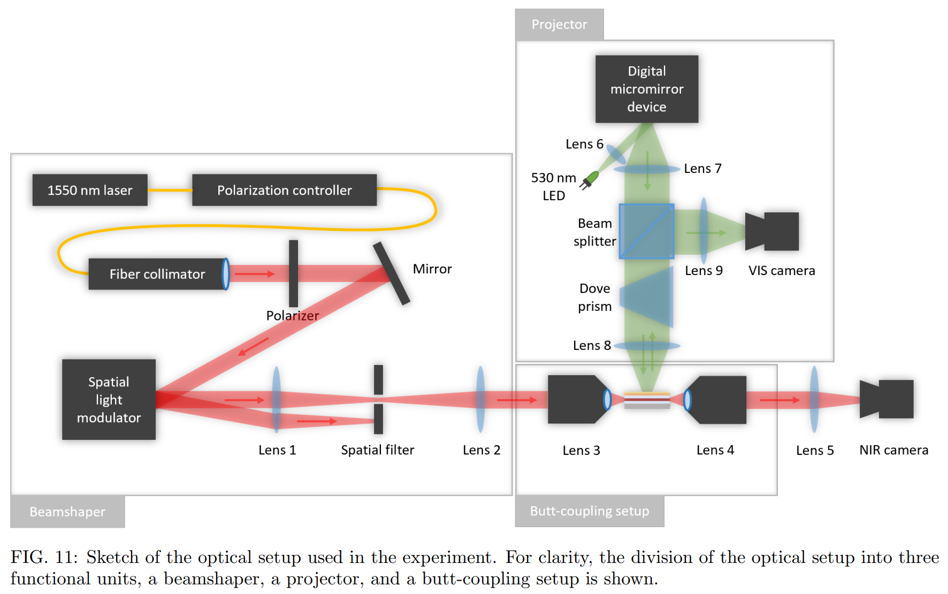

Slide 20
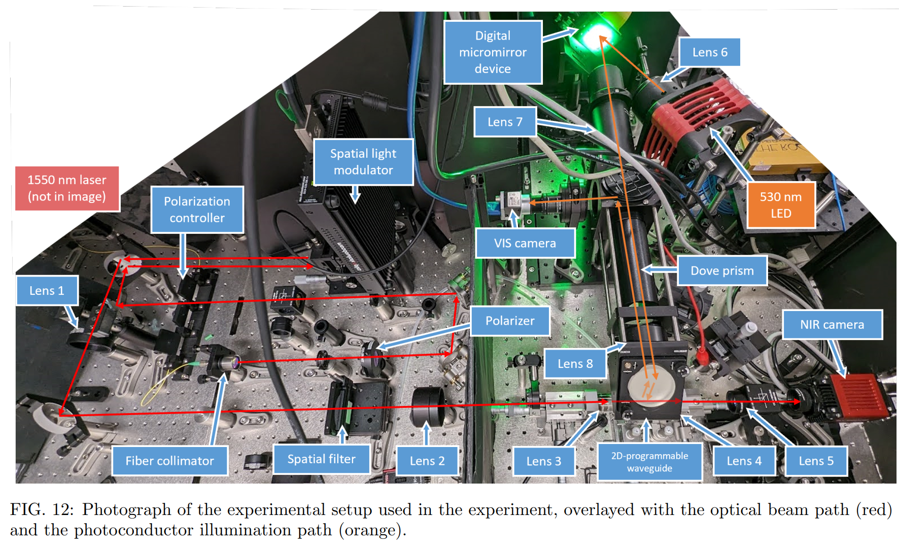

Slide 21
