Slide 1
Solid State Neuroscience
M. Rozenberg
Laboratoire de Physique des Solides (Orsay)
CNRS & Université Paris-Saclay
Damien described synapses using non-volatile memristors
I'll tell you about neurons using volatile memristors
Selected References:
Thyristor neuron
Bursting dynamics in a spiking neuron with a memristive voltage-gated channel Jiaming Wu et al 2023 Neuromorph. Comput. Eng. 3 044008
Solid State Neuroscience: Spiking Neural Networks as Time Matter M. Rozenberg Journal of Physics: Conference Series 2533 (1), 012007 (2023)
An ultra-compact leaky-integrate-and-fire model for building spiking neural networks. M. Rozenberg, et al; Scientific Reports, 9, 11123(2019).
Mott neuron
Exponential Escape Rate of Filamentary Incubation in Mott Spiking Neurons Rodolfo Rocco, Phys. Rev. Applied 17, 024028 (2022) Editors’ Suggestion
A Leaky-Integrate-and-Fire Neuron Analog Realized with a Mott Insulator P. Stoliar, et al; Adv. Funct. Mat. 27, 1604740 (2017)
Challenges in materials and devices for resistive-switching-based neuromorphic computing; Javier del Valle, et al; Journal of Applied Physics 124, 211101 (2018)

Slide 2
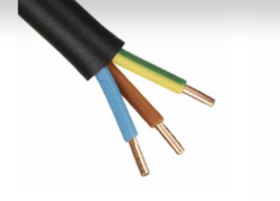
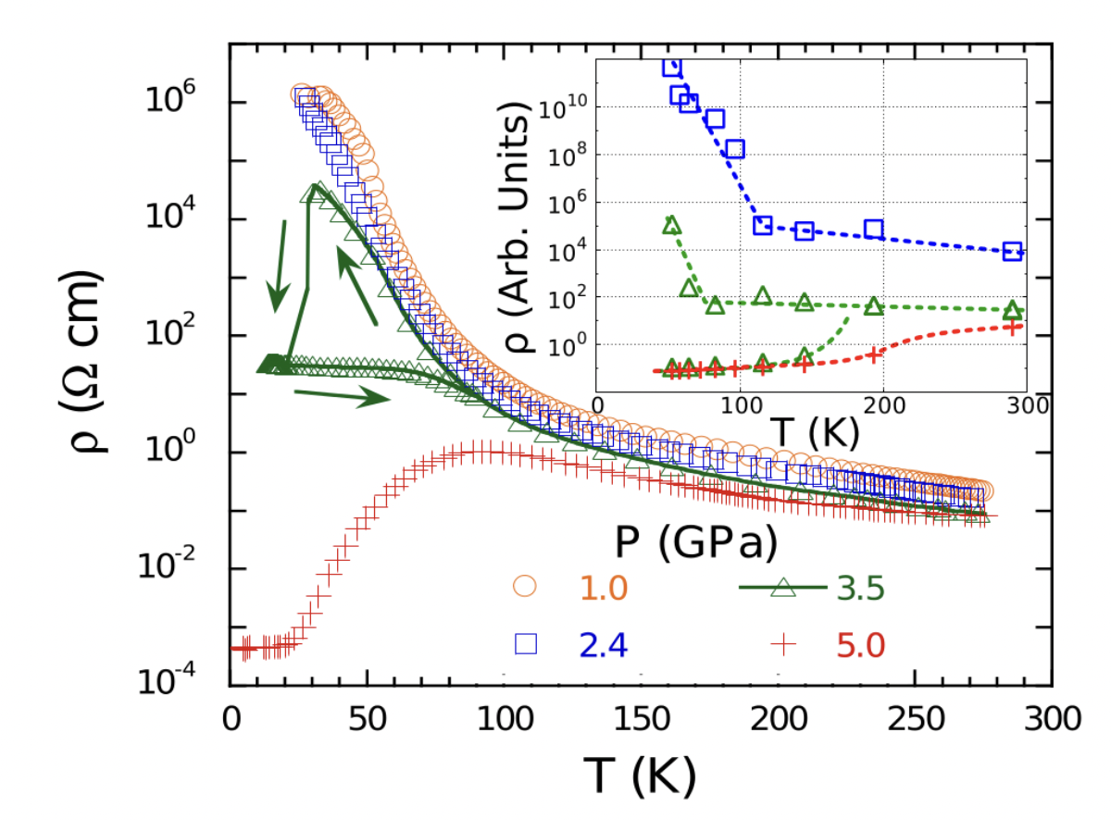
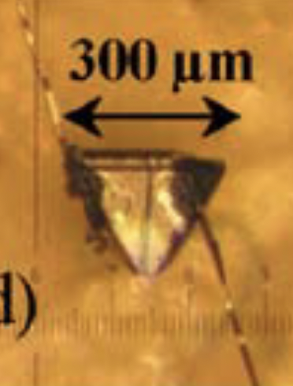
Ordinary matter:
cable made of metal (copper) and insulator (plastic)
Mott Materials (quantum matter)
Should be metals…. But are insulators
insulator to metal (1st order) transition
10 orders of magnitude!!
Strongly Correlated Material
GaTa₄Se₈
Acha, Camjayi @ UBA
Phys Rev Lett (2014)
L. Cario, E Janod @ IMN

Slide 3
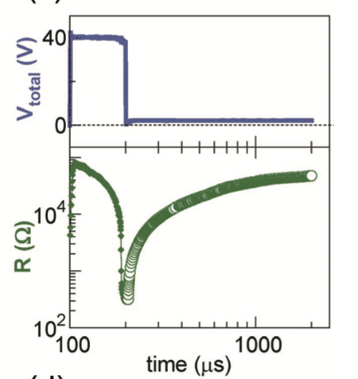
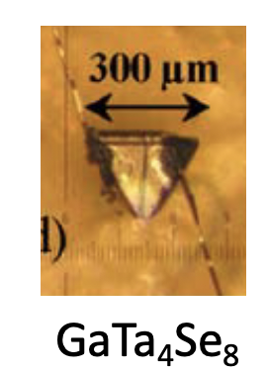
Surprise: Electrically driven Mott transition
Stoliar et al Adv Mar (2013)
Volatile
Resistive
transition
τ
Model
prediction
Experiment
Electric pulses provoke a collapse of resistance, then a surge of current!
1st Aha! Moment !!!!

Slide 4
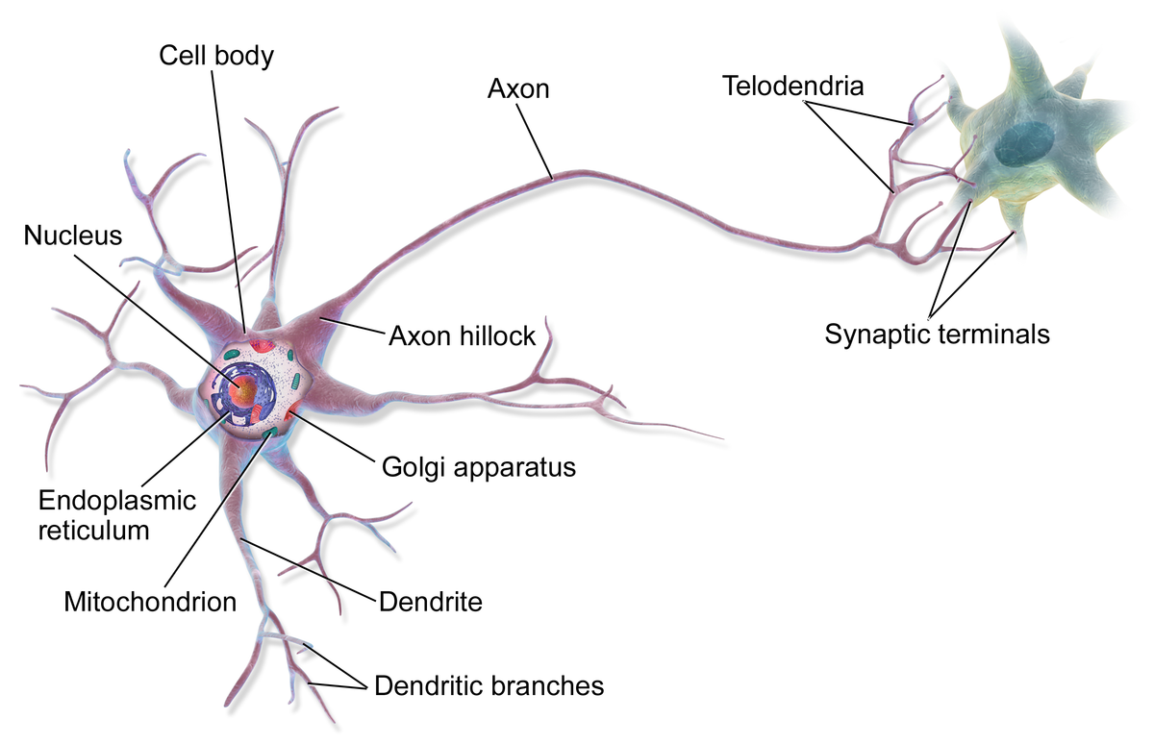
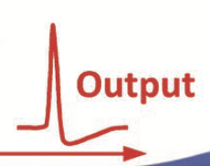
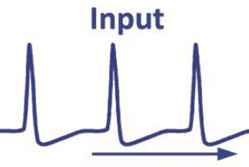
it is like what neurons do !!!
next neuron
A neuron is a cell
Generates and communicates
through electric signals
US Patent 10867237 (2020)
2017
Example of Physiscs first and then
Neurofunctional behavior

Slide 5
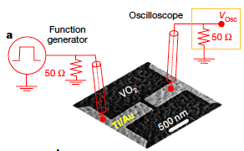
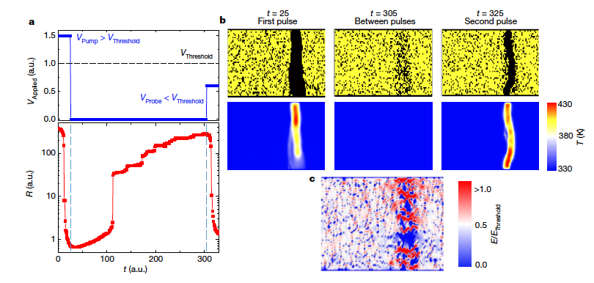
Towards physical artificial neurons
Mott materials (VO₂) are promising
But also difficult to make and control, and we are beginning to understand (filamentary conduction)
Silicon neurons are a reality
Everything can be done with conventional electronics
But silicon neurons are not that simple
Collab w/UCSD I. Schuller EFRC Q-MEEN-C
Indiveri, Stefanini, Chicca IEEE (2010)
Indiveri et al Front Neurosci 2011 (review)
Del Valle et al Nature 2019 Adda et al PRX 2022
Kalcheim et al Nat Comm 2020 Rocco et al PRApp 2022
Del Valle et al Science 2021

Slide 6
Can’t we have the “best of both worlds”?
Simplicity of Mott memristors
Reliability of conventional silicon electronics

Slide 7
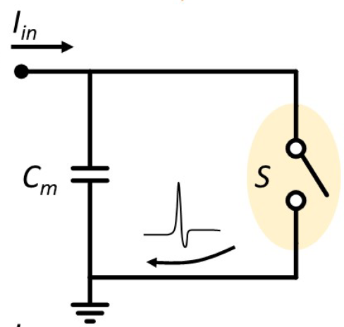
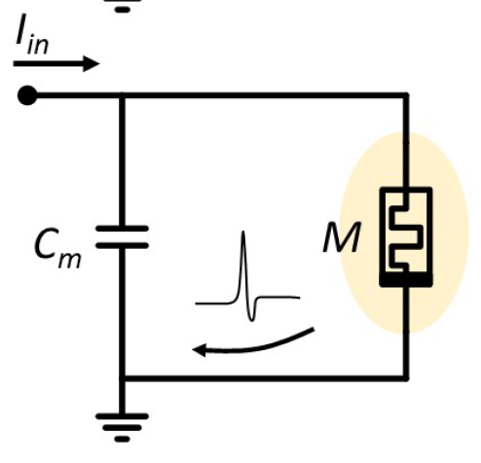
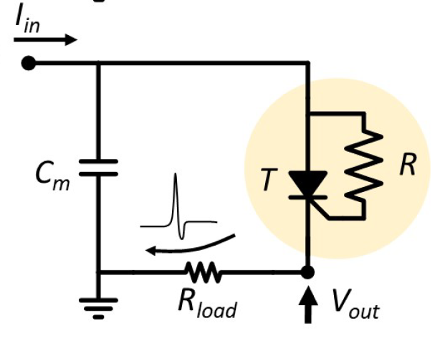
Best of both worlds: Memristive Silicon Spiking Neuron aka Thyristor neuron aka Ultra-Compact Neuron
2nd Aha! Moment !!!
MR, O. Schneegans and P. Stoliar, Sci Rep (2019)
memory-resistive effect ←→ hysteresis
Thyristor
Threshold control diode
V-gated ionic channel
Leaky-Integrate and Fire model
integrate
fire
leak

Slide 8
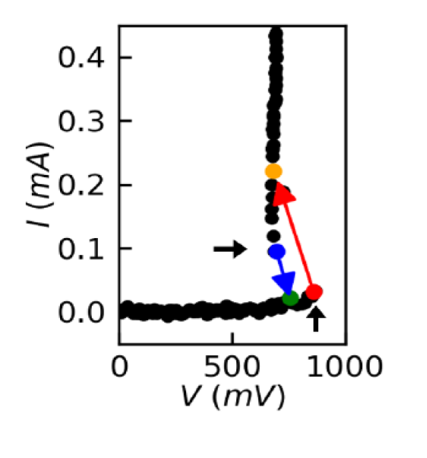
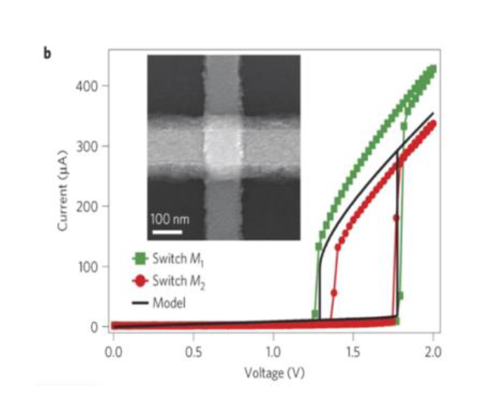
Best of both worlds: Memristive Silicon Spiking Neuron aka Ultra-Compact Neuron
Leaky-Integrate and Fire model
same I-V characteristics

Slide 9
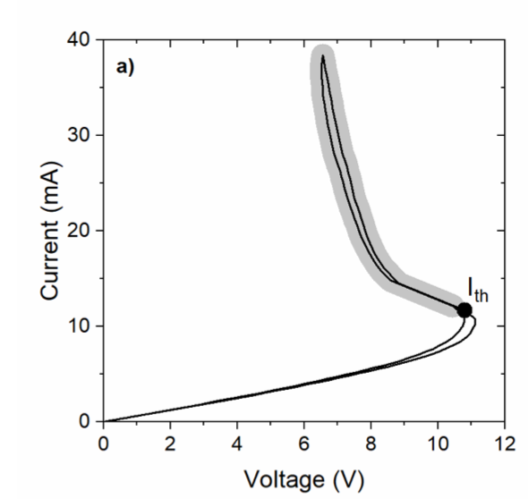
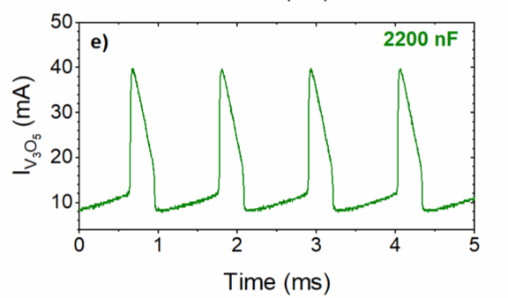
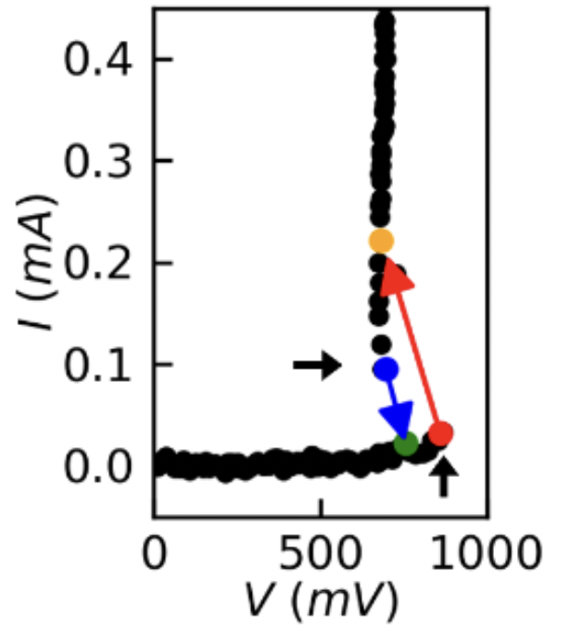
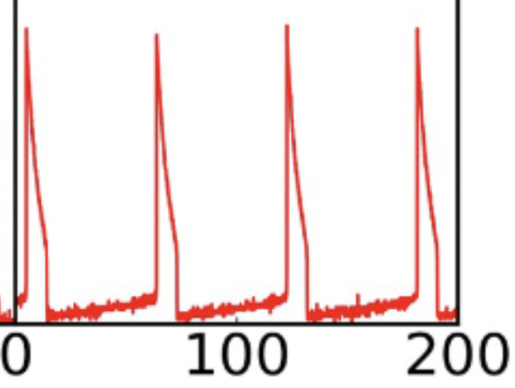
A thyristor-memristor-silicon-neuron fires like a Mott material
I-V characteristics
spiking
Mott materials (drawbacs)
- thin film deposition
- 10+ years of know how
- Hard to fabricate consistently
- Lithography equipment
Sputtering, PLD, etc
Mott
V₃O₅
Adda et al PRX 2021
Thyristors (advantages)
+ available on-line for
next day delivery, for pennies.
+ always work
100
Memristor
V (mV)
0
Sci Rep 2019
Wu et al NCE 2023 (to appear)
Time (ms)

Slide 10
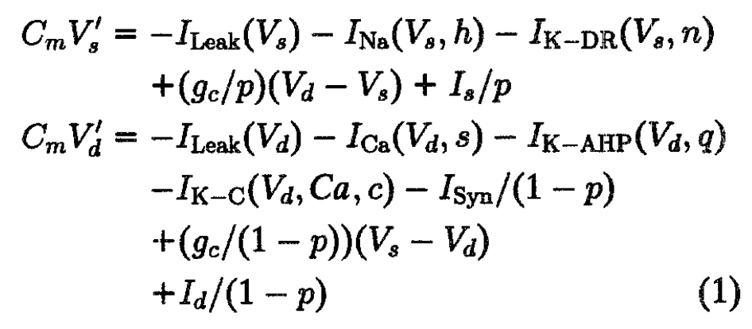
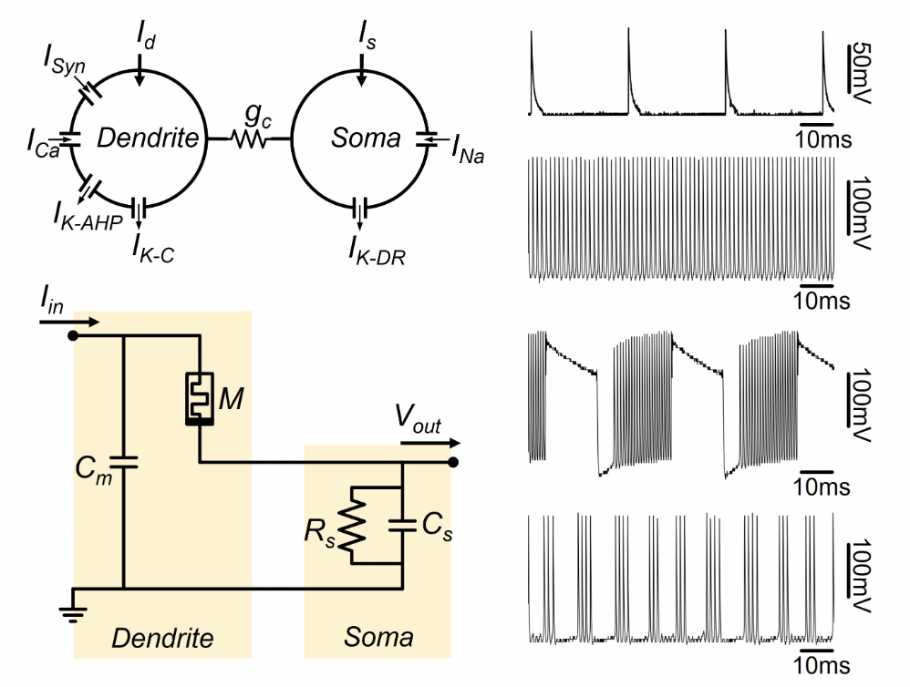
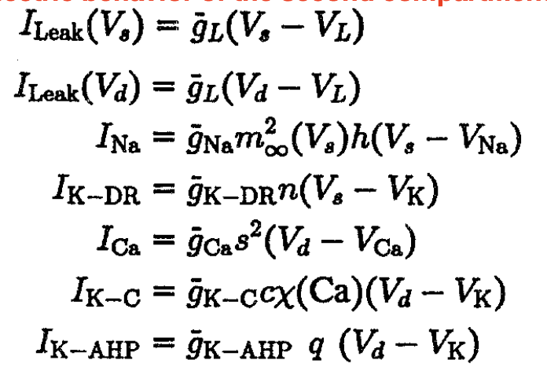
Memristive Bursting neuron
“the circuit is the model”
2-compartment Pinsky-Rinzel model
Wu et al Neuromorphic Coumputing and Engineering 2023 (to appear)

Slide 11
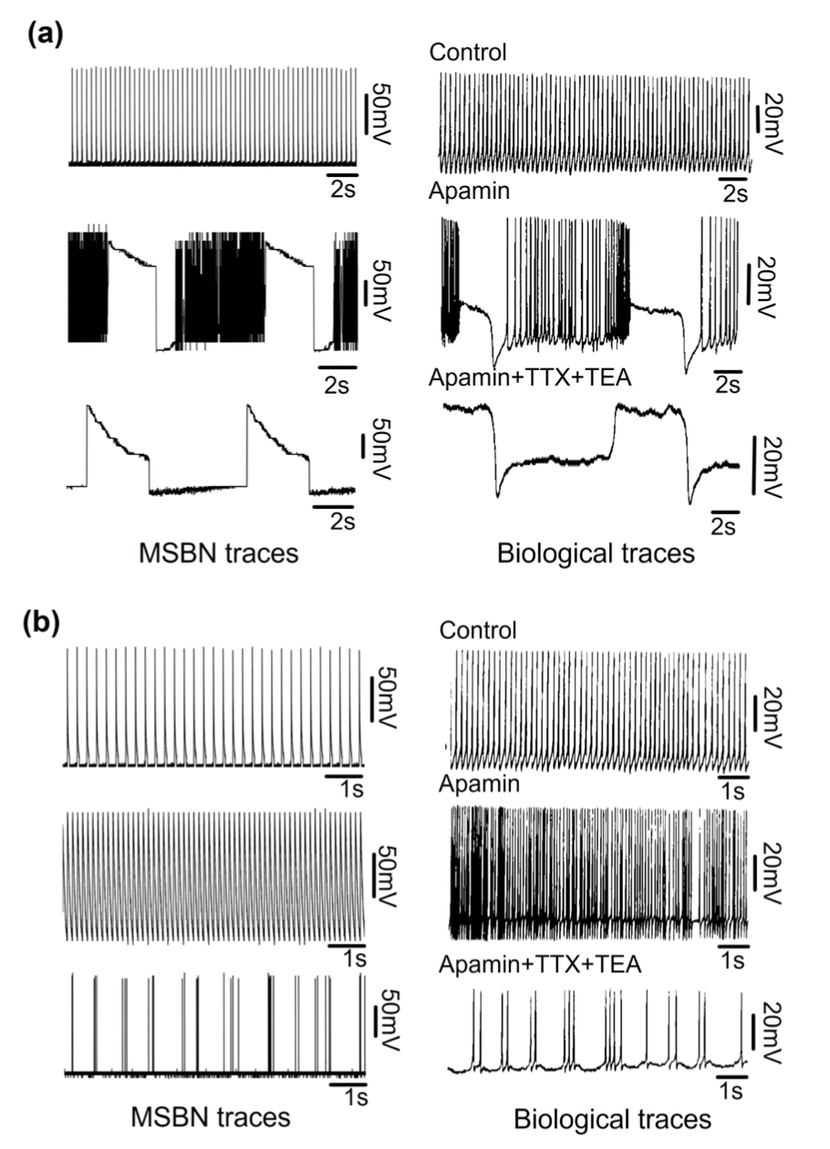
Memristive Bursting neuron
Model neuron
Biological bursting
+ neurotoxins
2-compartment Pinsky-Rinzel model
Wu et al Neuromorphic Coumputing and Engineering 2023 (to appear)
Das Sarma et al Molecular Autism 11, 52 (2020).
Ping et al Neuroreport 7, 809 (1996).

Slide 12
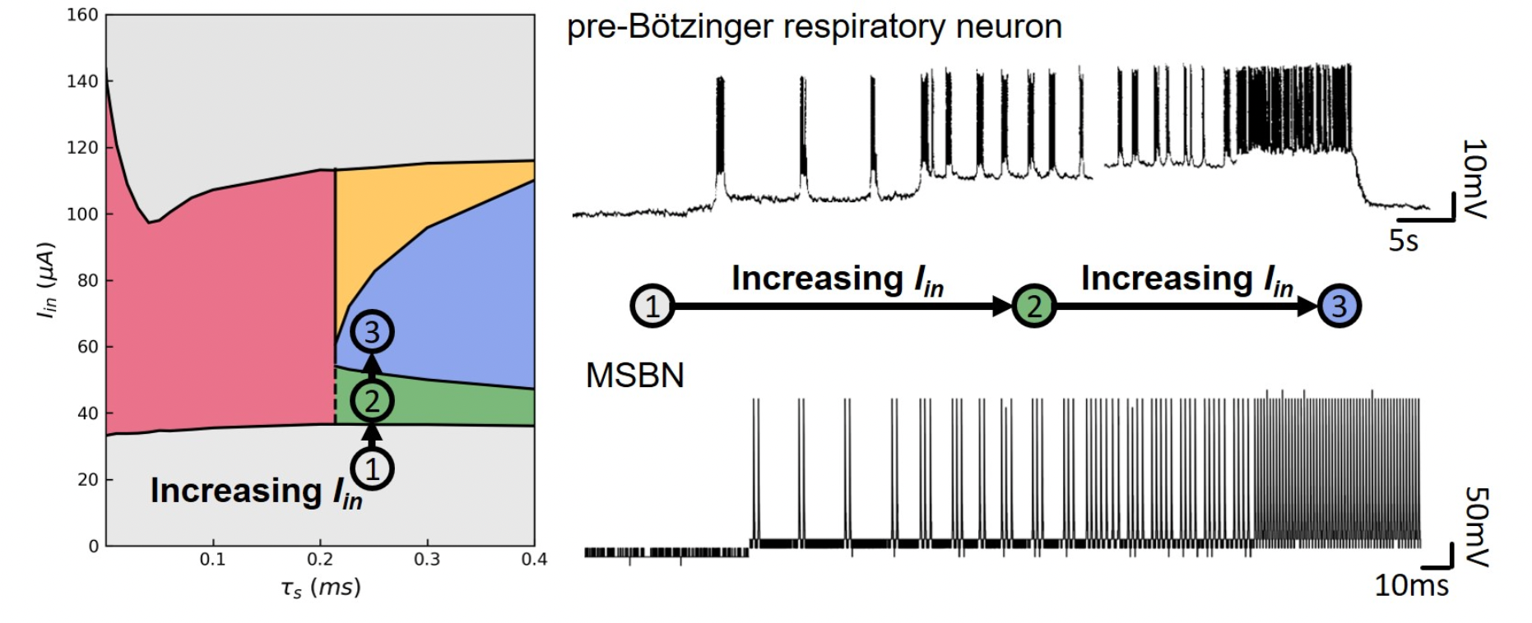
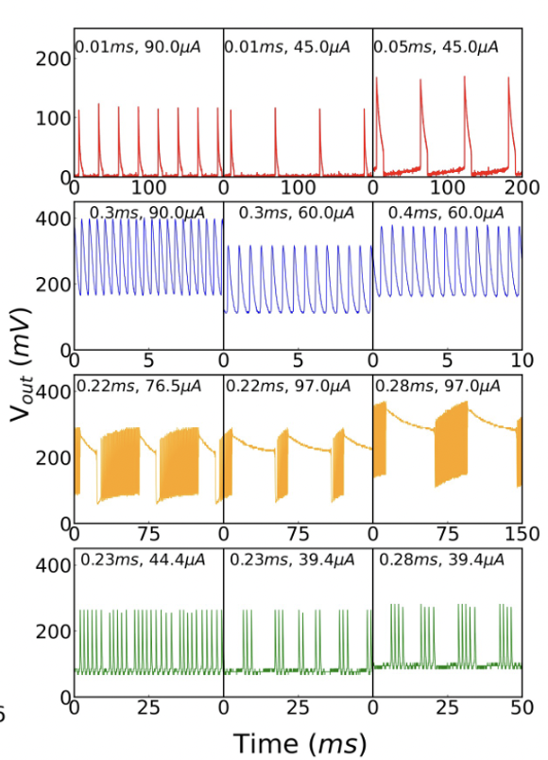
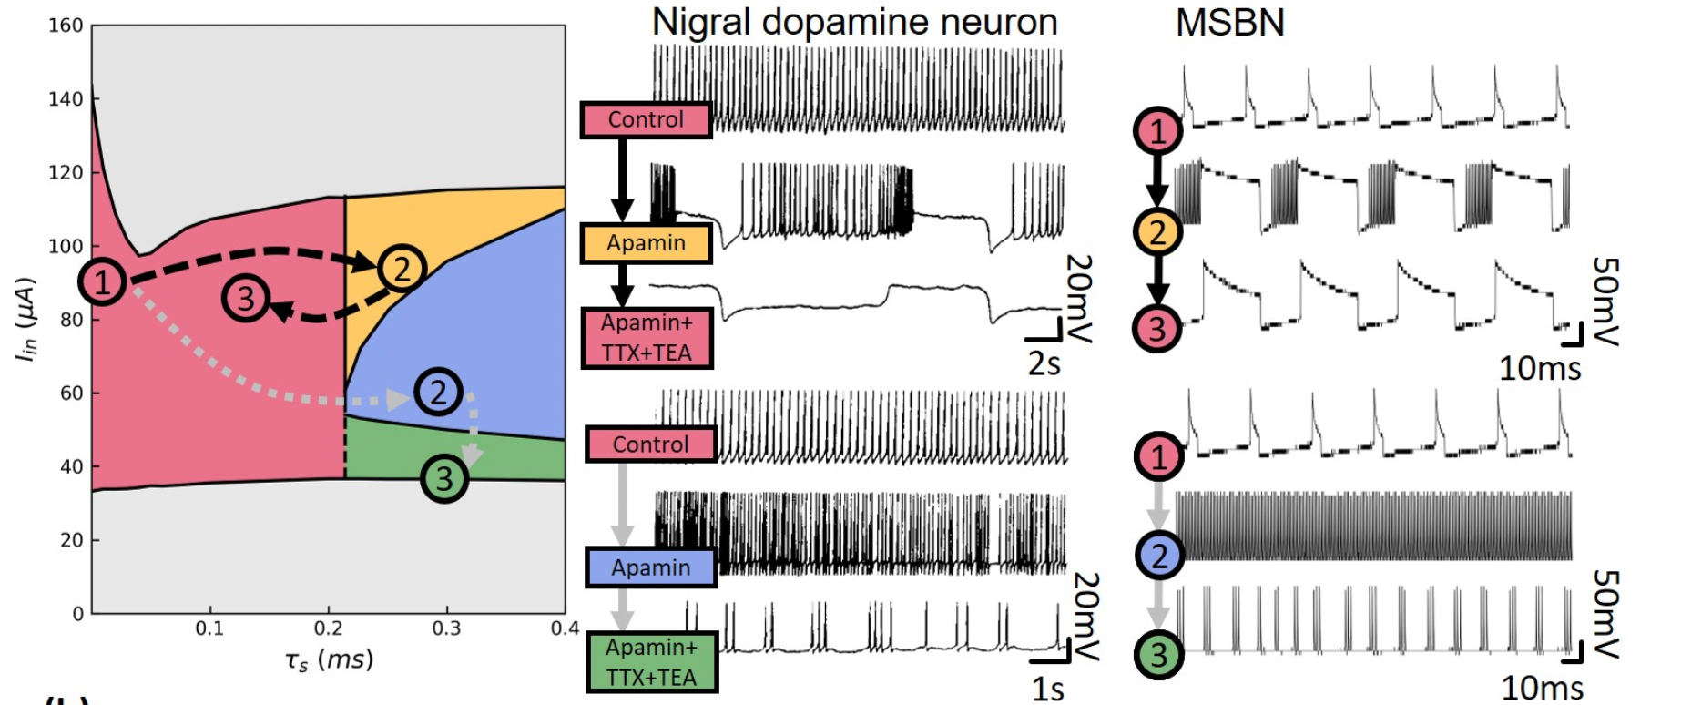
quiescent
The phase diagram as a
map for neuronal spiking
behavior
FS
TS
quiescent
FS
TS
quiescent
Wu et al Neuromorphic Coumputing and Engineering 2023 (to appear)

Slide 13
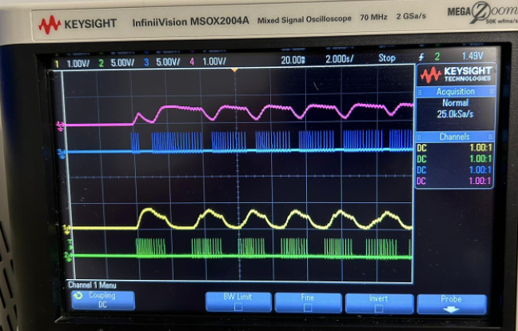
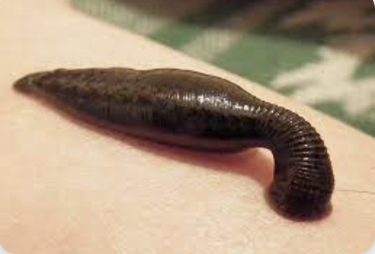
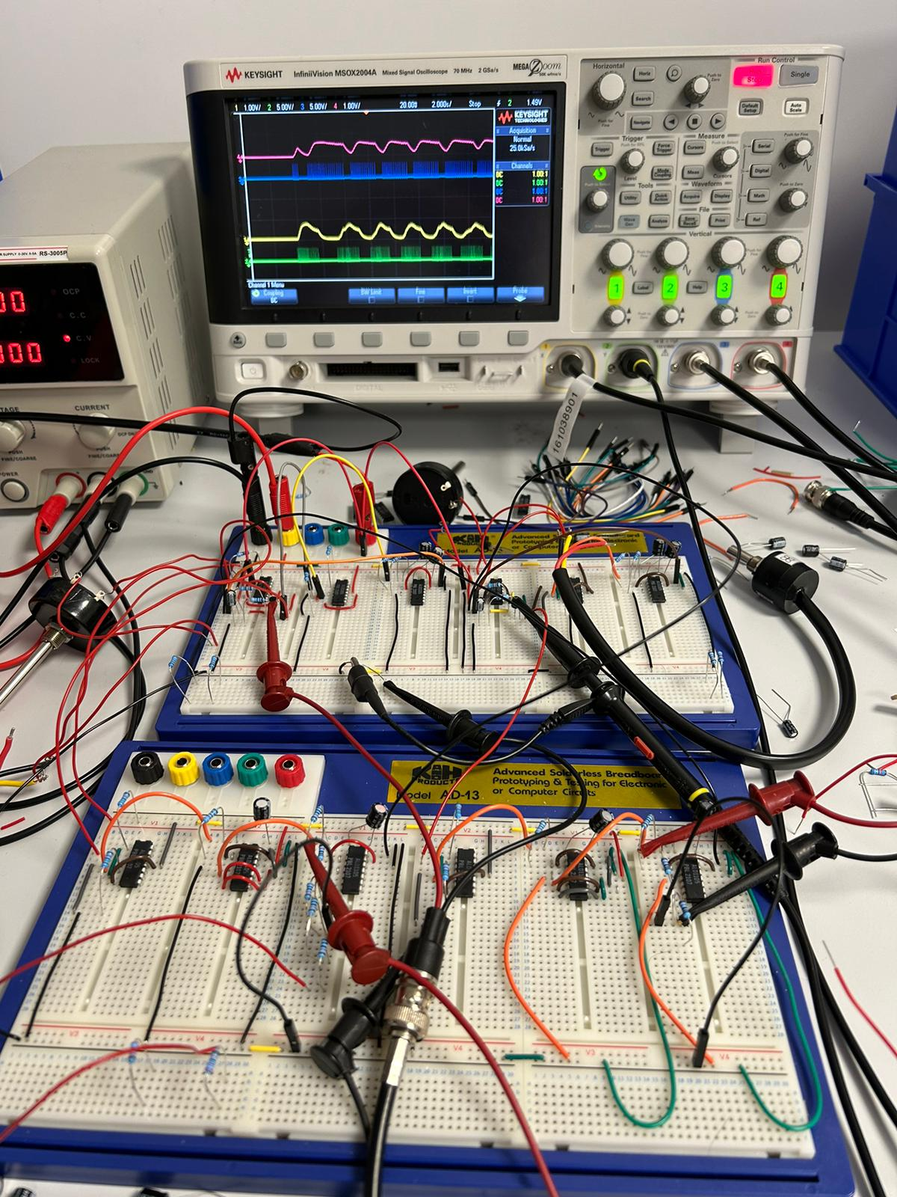
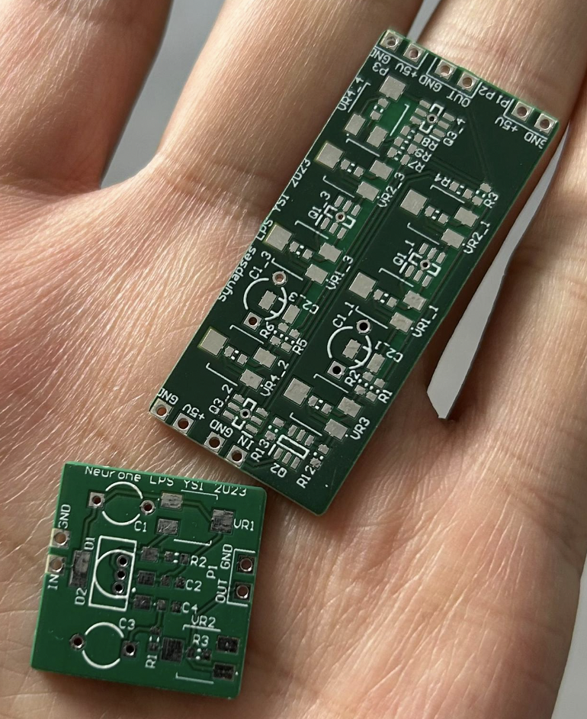
Start to build Spiking Neural Netwoks
Central Pattern Generator (CPG)
Leech heartbeat
Hill et al 2001
Two mutually inhibitory spiking neurons with adaptation
N1
N2
Jiaming Wu

Slide 14
“What I cannot create, I do not understand” (R. Feynman)

Slide 15
Thank you!

